Slide 1
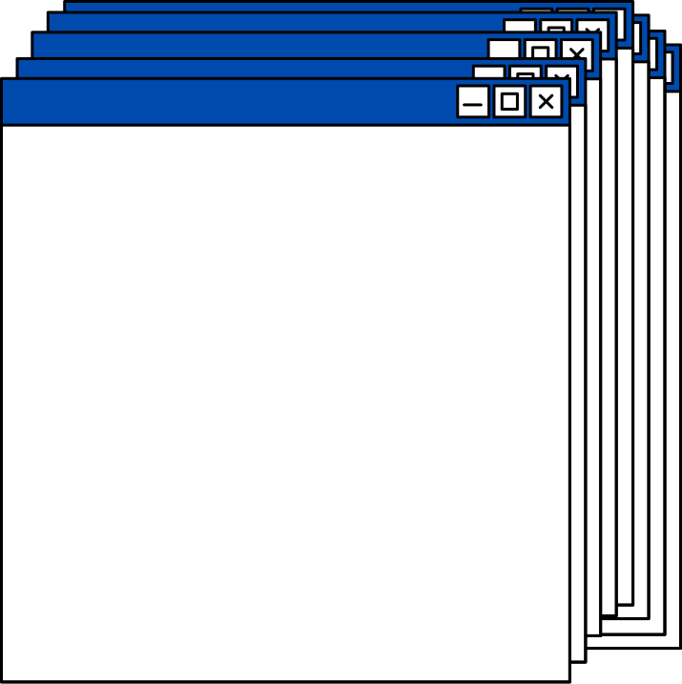



VIRTUAL FISHING
101
THINK BEFORE YOU CLICK!
REALLYGREATSITE.COM

Slide 2
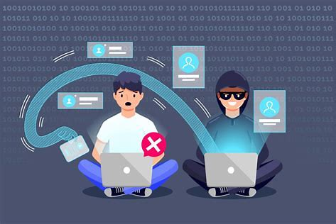
What is Phishing?
> Phishing attempts usually come through email.
> Scammers use email because it's easy to spoof the "From" address and make it look like the email is from your bank, a popular store, a government agency, etc.
> They often base the messages on things people would plausibly get emails about, like your bank, Amazon orders, Package tracking notices from UPS or FedEx, or password reset requests from Facebook or Gmail.

Slide 3
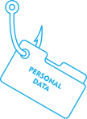
Types of phishing emails
Emails Demanding Urgent Action
Emails with Bad Grammar and Spelling Mistakes
Emails with an Unfamiliar Greeting or Salutation
Inconsistencies in Email Addresses, Links & Domain Names
Suspicious Attachments
Emails Requesting Login Credentials, Payment Information or Sensitive Data
Too Good to Be True Emails
Image based or QR code generated
Credential harvesting
Brand impersonation

Slide 4
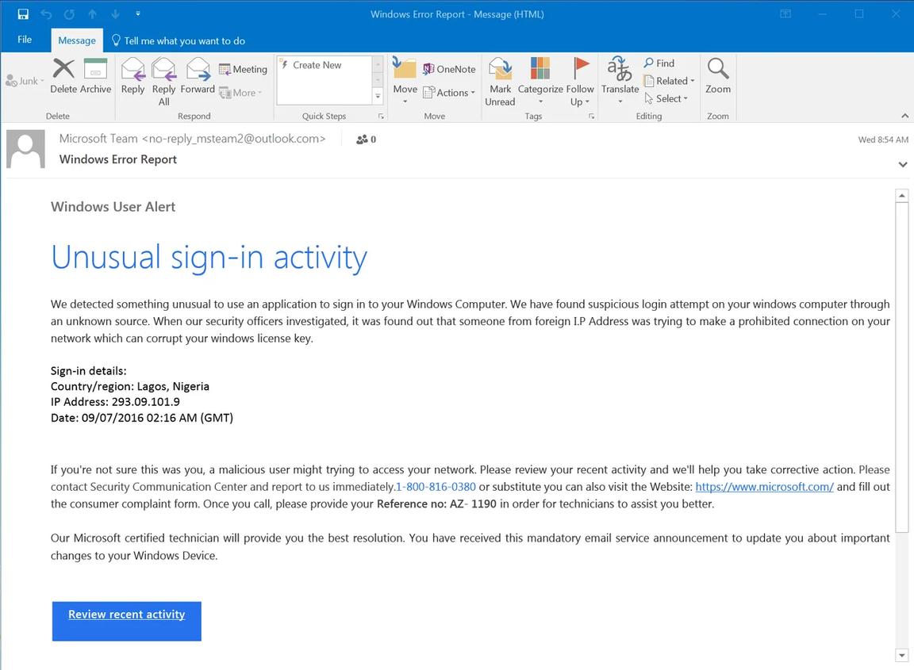
Examples of phishing attacks
Example 1 : A fake Microsoft notice, almost identical in appearance to an actual notice from Microsoft concerning "Unusual sign-in activity". This email points users to a phony 1-800 number instead of kicking users to a credentials phish.

Slide 5
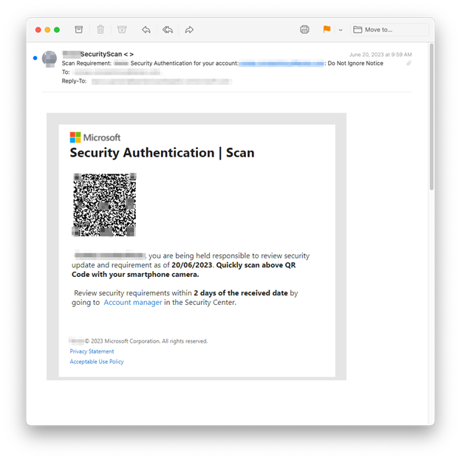
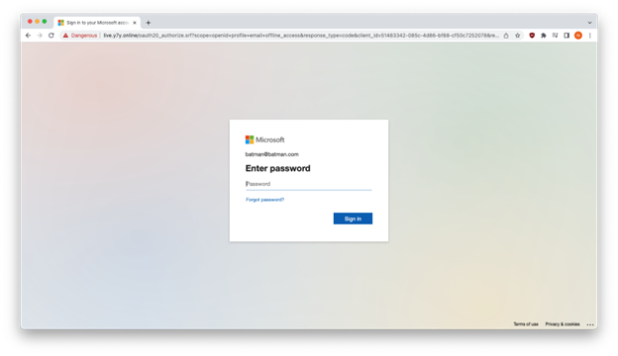
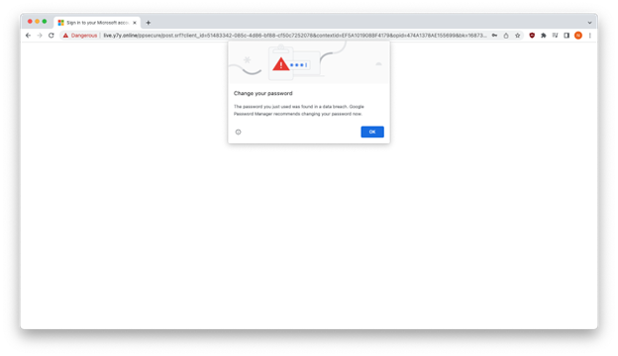
Example 2 : QR code phishing email
3. Google Chrome warned us that y7y[.]online harvested the fake credentials which the user entered. phishers will be able to easily obtain the credentials of vulnerable, unprotected victims.
1. Hijacking an account of a companyg
2. The Microsoft impersonation site accepted the fake credentials.

Slide 6

REPORT PHISHING ATTEMPTS
If you suspect a phishing attempt, report it to the IT department. Please don't forward the phishing email or message to another user. You can show them on your device. Forwarding phishing emails could lead to others being phished.
Reporting phishing attempts helps protect others from falling victim to the scam.

Slide 7

10 ways to avoid phishing scams
Use Antivirus software.
Use Firewalls
Think Before You Click!
Keep Informed About Phishing Techniques
Install an Anti-Phishing Toolbar
Verify a Site’s Security
Check Your Online Accounts Regularly
Keep Your Browser Up to Date
Be Wary of Pop-Ups
Never Give Out Personal Information

